Slide 1
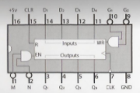
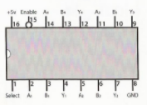
Ben Eater’s 8 Bit Computer
MAR PINOUTS
74LS173:
4-bit D register
74LS157:
2-to-1 line selector

